Slide 1
“Perfect” PBLI template
Sperling 4/20

Slide 2
Objectives
2-3 things I want my audience to know or understand at the end of this presentation
Utilize this template to construct an effective EBM presentation
Speak clearly, slowly, and minimize the number of words/slide

Slide 3
Patient case
Brief, bullet pointed encounter including the question patient asked me or that I asked based on the encounter

Slide 4
Clinical question in PPICO format
Patient
Problem
Intervention
Comparison
Outcome-ideally a patient-oriented outcome (morbidity, mortality, cost)

Slide 5
Disease background
VERY BRIEF IF AT ALL
ONLY IF NECESSARY TO EXPLAIN HOW/WHY YOU FORMULATED YOUR QUESTION

Slide 6
Search process
Search terms
Sites used
What you found
Why you chose your particular article

Slide 7
Study design and findings
1 or 2 bullet pointed slides

Slide 8
Relevance-How well does this article answer my question
My PPICO
Article PPICO

Slide 9
Validity
FRISBEE or other relevant checklist
Additional thoughts you have about strength/weakness of study (size of study, funding source, etc)

Slide 10
NNT
Applicable if the study had a binary or yes/no result
NNT = 1/ARR
If no statistical difference between intervention and control then NNT is infinite

Slide 11
POEM vs DOE
POEM=morbidity, mortality, cost
DOE=improvement in a lab or xray finding

Slide 12
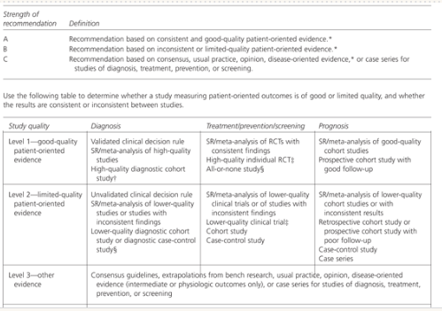
Level of evidence, Use a standardized rating scale such as SORT

Slide 13
What you would tell the patient

Slide 14
Summary
2-3 take home points

Slide 15
References and Questions

